Slide 1


PyIU Advanced Python Workshop:
Accessing Python
10/19/24
NASA, ESA, CSA, and J. Lee (NOIRLab), A. Pagan (STScI)
ACCESSING PYTHON LOCALLY AND ON IU’S SUPERCOMPUTERS
Brandon Radzom

Slide 2

Python & Anaconda/miniconda
Anaconda/miniconda is a distribution platform for Python
The Conda environment handles issues & dependencies for you
Anaconda Navigator: graphical user interface for Conda
miniconda: lightweight version of anaconda, good if you have multiple environments

Slide 3
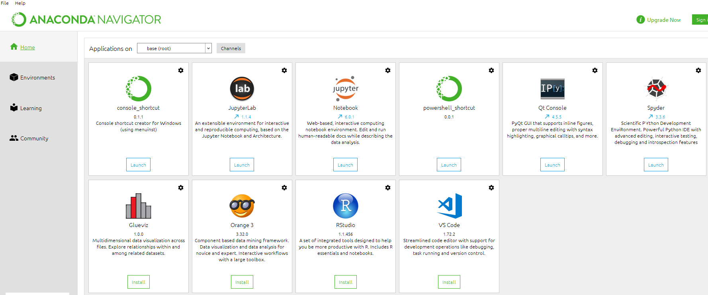
Anaconda Installation (personal computer)
Go to: https://www.anaconda.com/products/distribution
View from “Navigator” should look like:

Slide 4
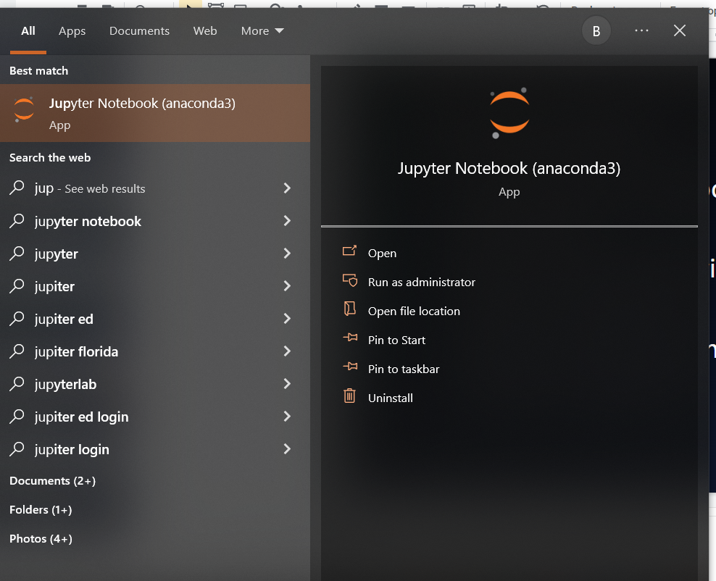
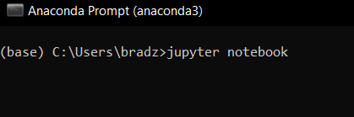
Running Jupyter
Personal computer:
Open the “Anaconda Navigator” -> click “Launch” under Jupyter logo
Type “Jupyter notebook” in your local search bar
Open the “Anaconda Prompt” -> enter “jupyter notebook”

Slide 5
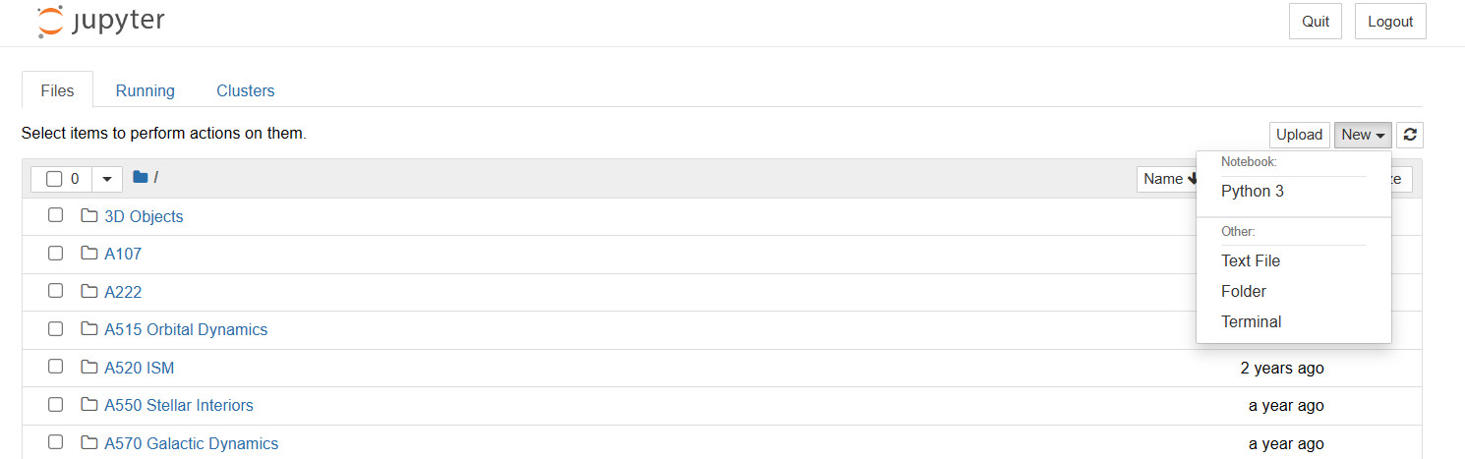
Start a Jupyter notebook
“New” -> “Python 3”
Write your code!

Slide 6

Super serious about research? Check out IU’s supercomputers!
Big Red 200
8,000,000,000,000,000 operations/sec
640 compute nodes, 64 GPU-accelerated
Quartz
92 compute nodes
Large amounts of processing capacity over long periods of time
Emily Sterneman, Indiana University

Slide 7
IU’s Research Desktop (RED)
Graphical desktop service for Quartz users
Unix-like system, 80 GB user memory
92 nodes, each with 2x64 cores, 512 GB RAM
As an IU student, you can access Python on RED
First request Computing Account
Then access RED via Thin Linc
Finally, load & start Python!

Slide 8
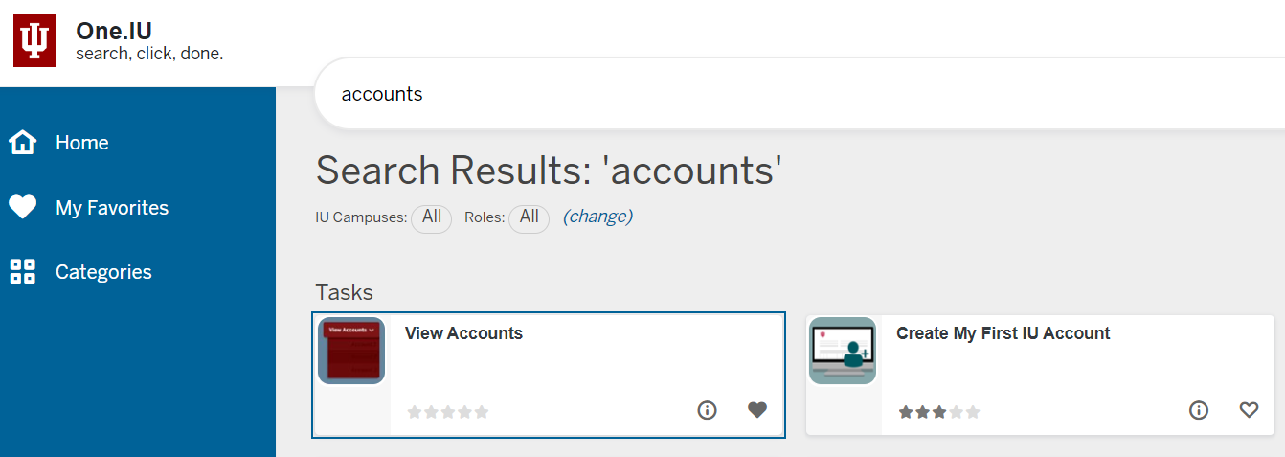
Step 1: Check one.iu.edu for accounts

Slide 9
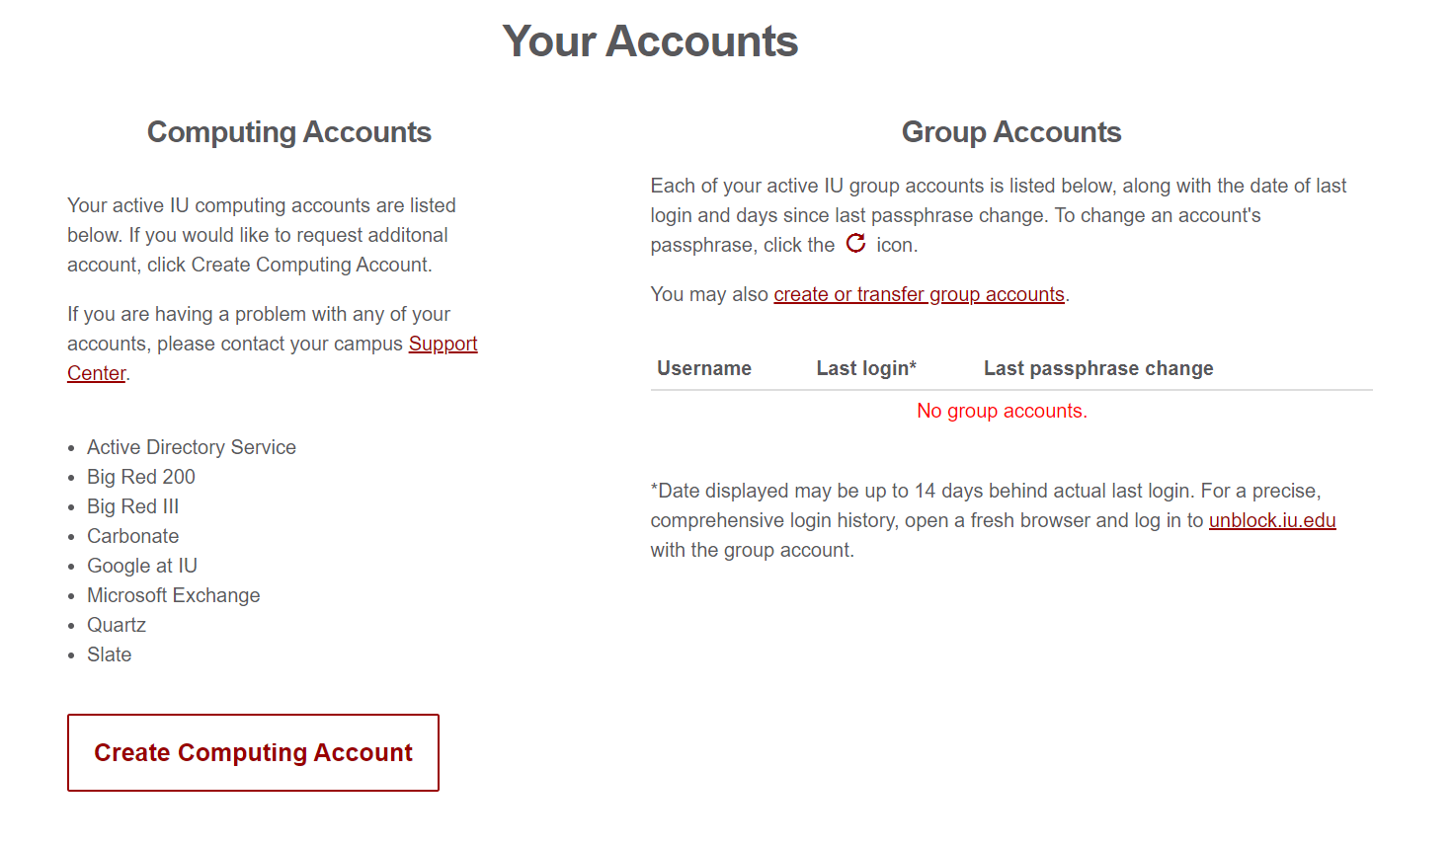
Step 2: Create Computing Account

Slide 10
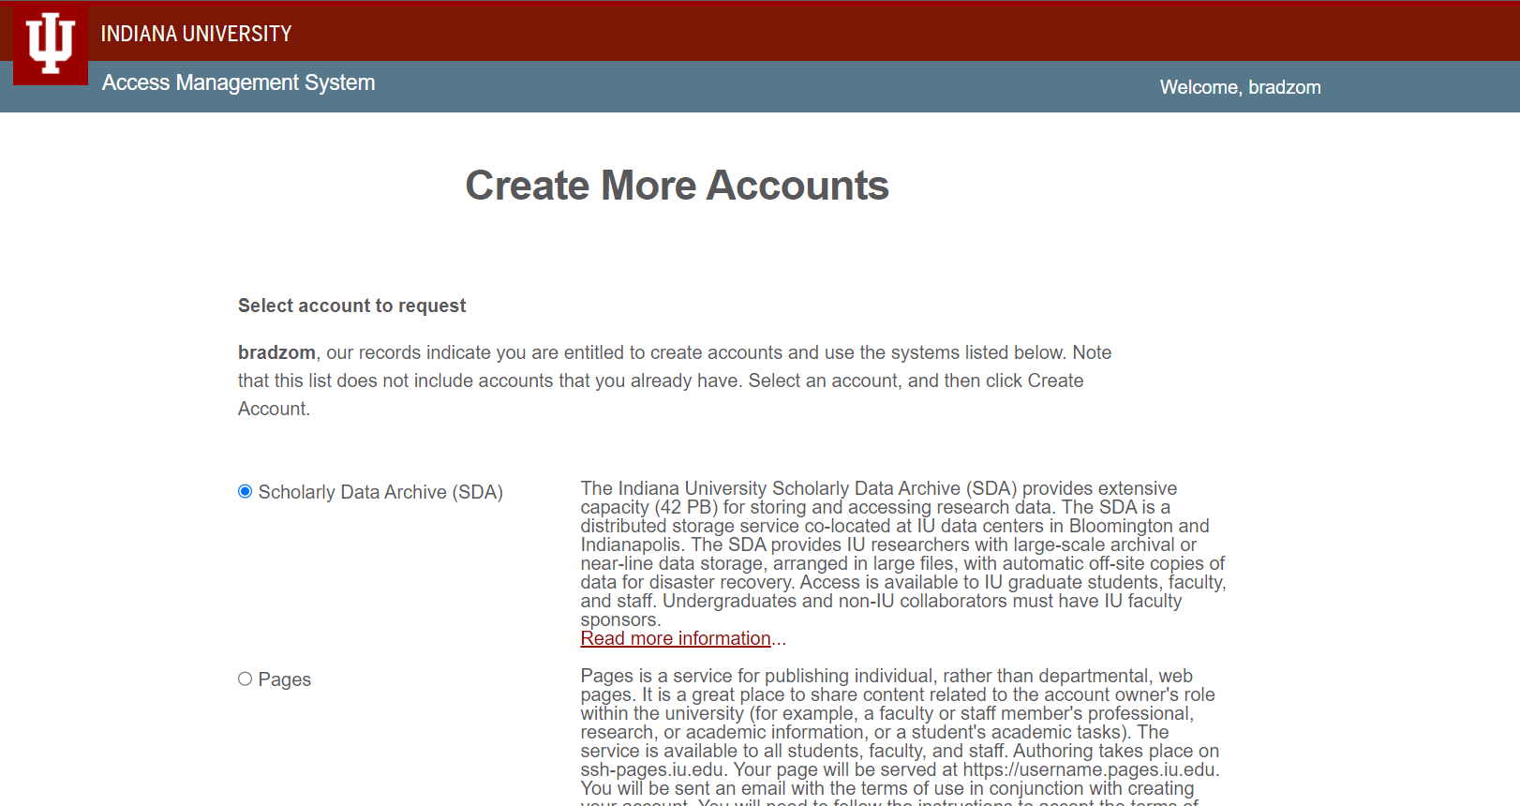

Slide 11
Step 3: Request Quartz/Slate Computing Accounts
Select “Quartz” and “Slate”
Quartz = computer cluster
Slate = storage
~20 min for account creation
Knowledgebase page for help:
First account? https://kb.iu.edu/d/achn
Additional account? https://kb.iu.edu/d/achr

Slide 12
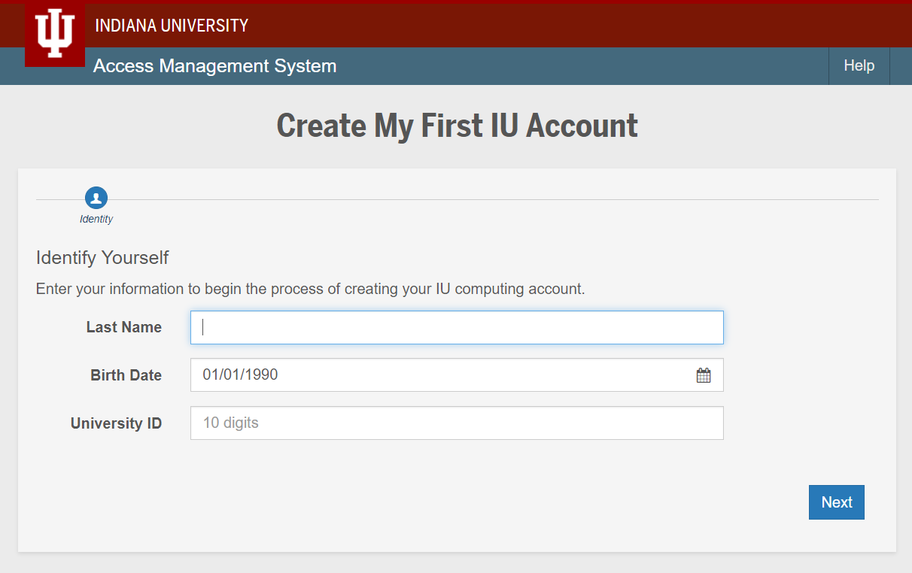

Slide 13

Step 4: Accessing RED/Quartz with ThinLinc
Login at https://red.uits.iu.edu/
If you want to install ThinLinc client onto your personal machine, follow the directions at https://kb.iu.edu/d/aput
Follow ALL instructions through “Public key authentication” (this part is unnecessary and tricky)

Slide 14
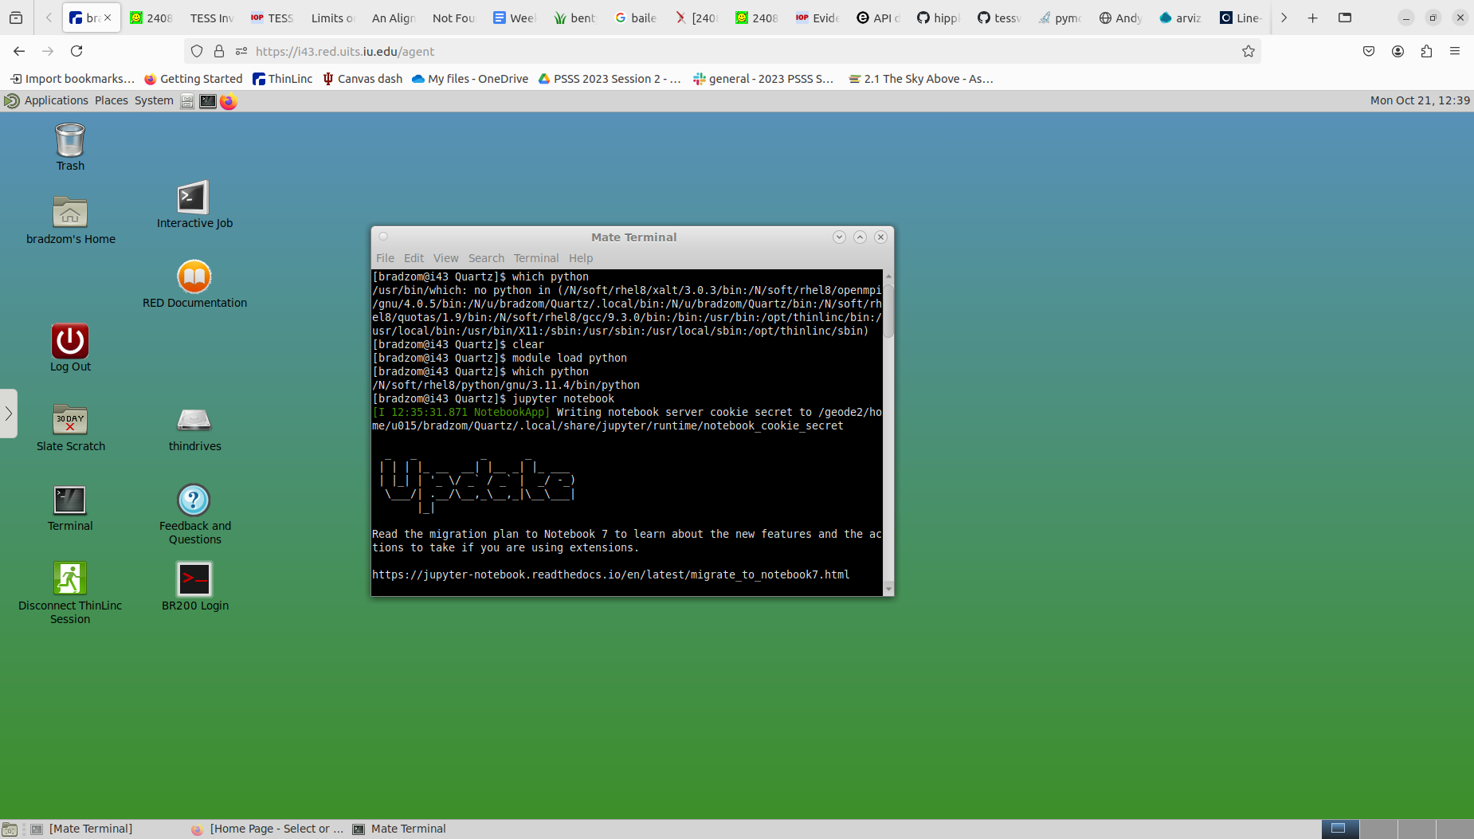
The RED desktop

Slide 15
Step 5: Setting up Python/jupyter on RED
Open the Terminal
Type “module load python”, enter
*Note you can add the “load” command to your .modules file in your home directory on Quartz to avoid repeating this every time

Slide 16
Step 6 (final): Run Python on RED
Open Terminal -> enter “jupyter notebook”
Start your notebook and begin coding!
Note: When logged on to RED, all code is run on a Quartz node- make use of its CPUs! (nodes may be shared sometimes)

Slide 17
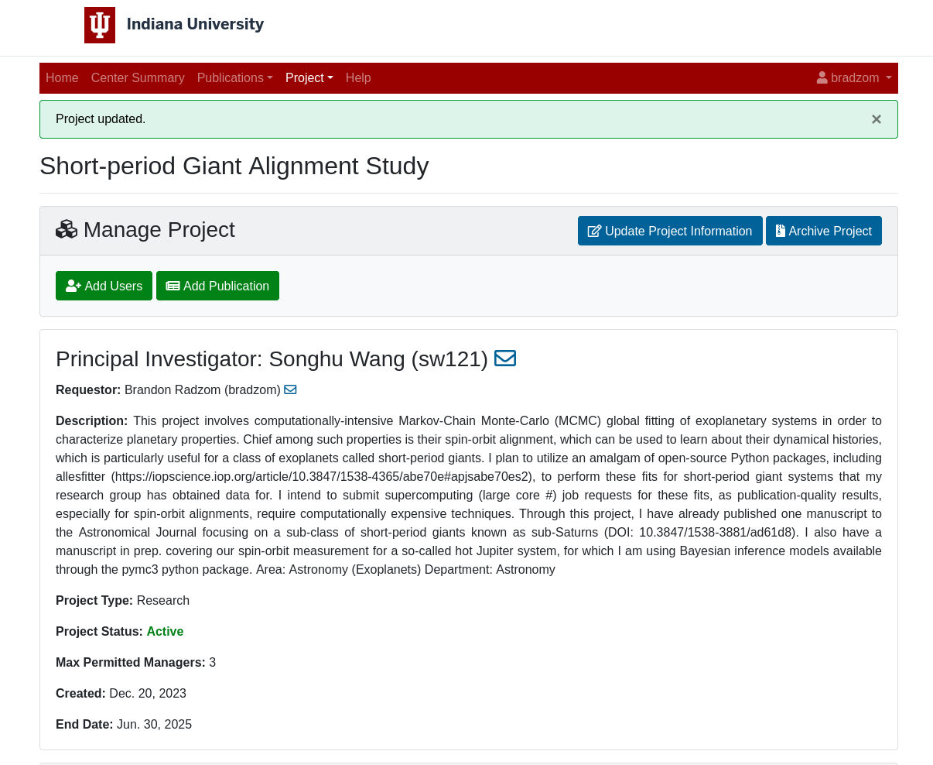
RT Projects and Computing Jobs
Some code will require hours or even days to run, useful to submit “jobs” on the supercomputers for these
Need an RT Projects account: https://projects.rt.iu.edu/
Must have faculty advisor approve and be co-I on a project
Can specify parameters
Jobs are managed by “Slurm”, can check status

Slide 18
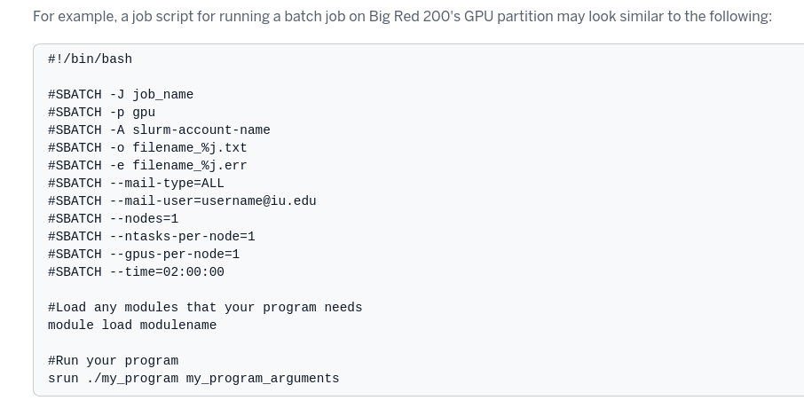
Specifying Job Parameters

Slide 19
A note on conda environments on RED
Environments are useful for focused, contained projects requiring niche third-party or custom packages, or specify Python versions
“module unload python” is needed to clear previous Python install
“module load miniconda” will load lightweight version of anaconda called miniconda
“conda create -p /N/slate/username/env_name pkg1 pkg2 pg3” will create environment in your Slate (recommended)
“conda activate env_name” will activate environment, “deactivate” to deactivate environment
Follow directions at IU’s kb article: https://servicenow.iu.edu/kb?id=kb_article_view&sysparm_article=KB0022379

Slide 20
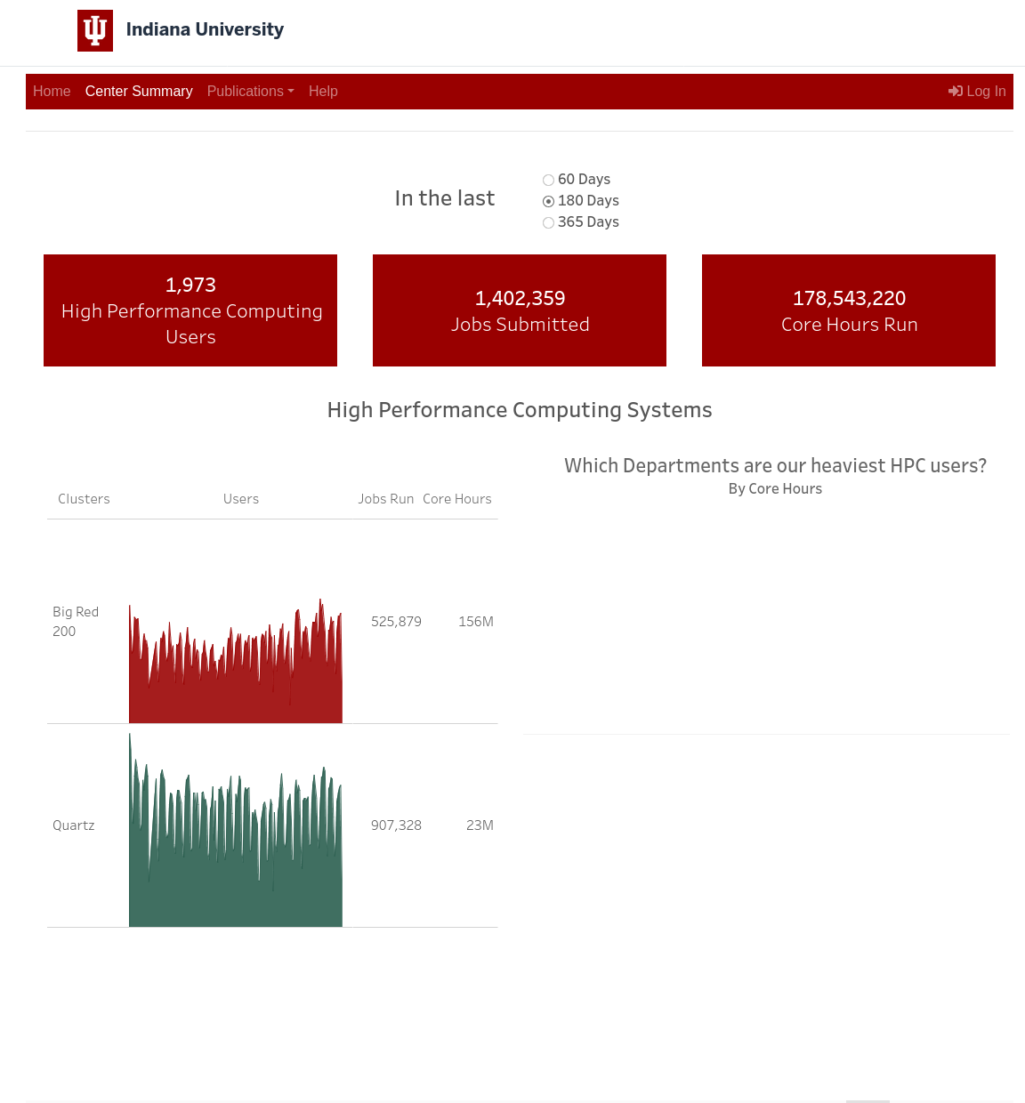
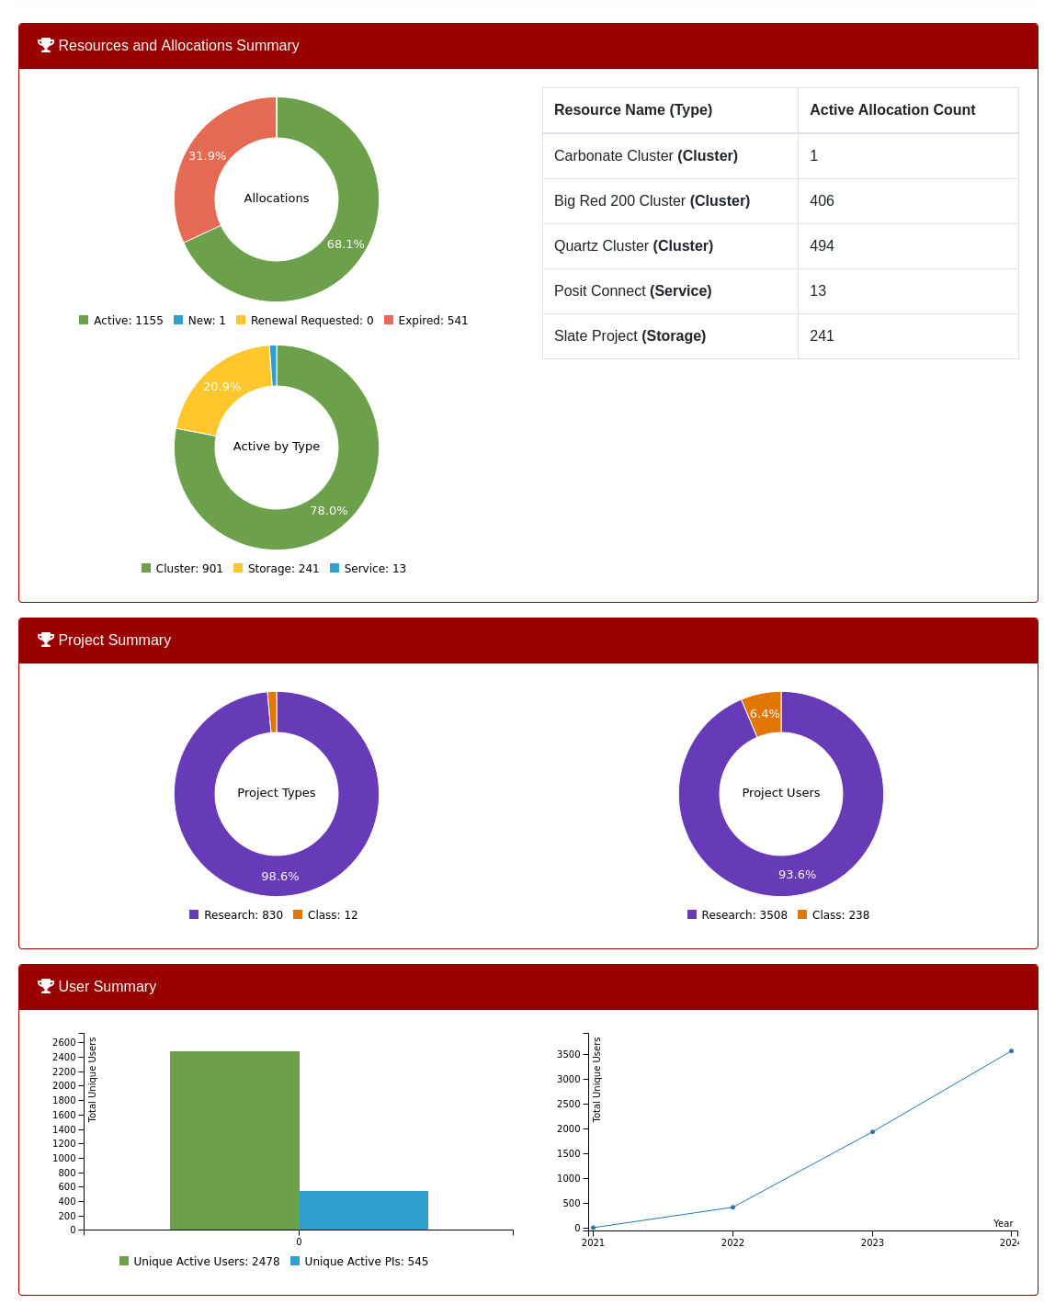
RT Project Center Summary https://projects.rt.iu.edu/center-summary
Summary of usage stats

